Slide 1
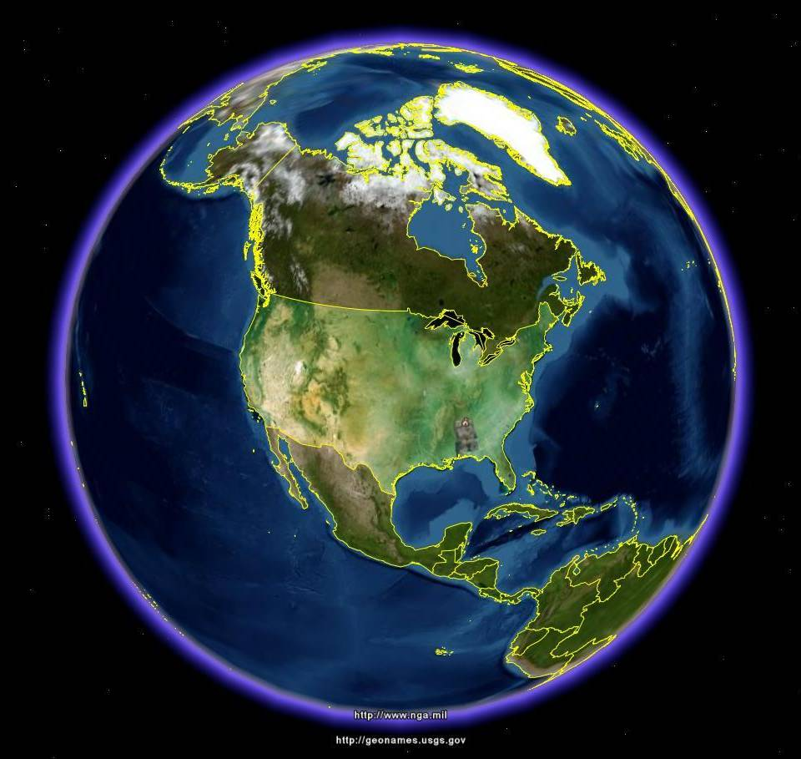
Government as a Platform:
The Homeland Security Example
Virtual USA

Slide 2
White House Memo on Open Government and Transparency 1/21/09
“Government should be collaborative. Collaboration actively engages Americans in the work of their Government. Executive departments and agencies should use innovative tools, methods, and systems to cooperate among themselves, across all levels of Government, and with nonprofit organizations, businesses, and individuals in the private sector.”

Slide 3
O’Reilly’s Maxims:
How to Create “Government as a Platform” for Engagement and Collaboration
Embrace Open Standards
Make it Simple
Design for Cooperation
Learn from Users
Lower the barrier to experimentation
Culture of Measurement
Throw Open Doors to Partners

Slide 4
A Big Challenge: A Large and Fragmented Community

Slide 5
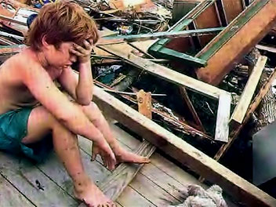
Making Information Actionable To
Enable Collaboration

Slide 6
Purpose & The Four Takeaways
Purpose: Bring data together to make better decisions.
Takeaways:
            Focus on Collaboration
            Design for the End User
            Sustainability
            Local Ownership

Slide 7
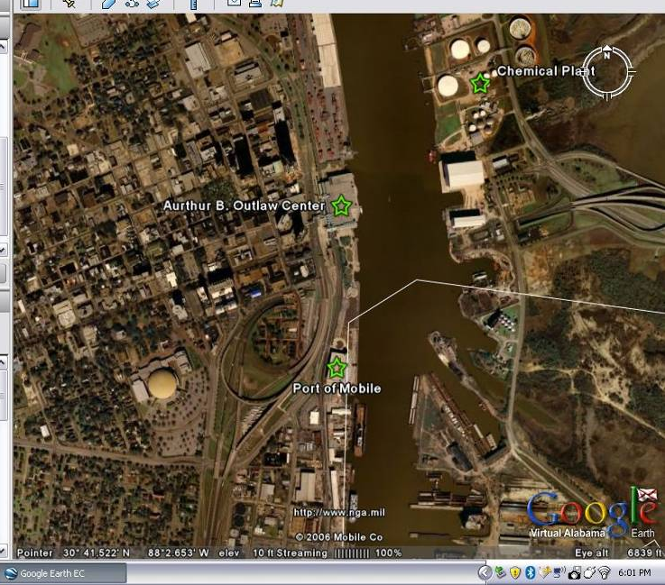
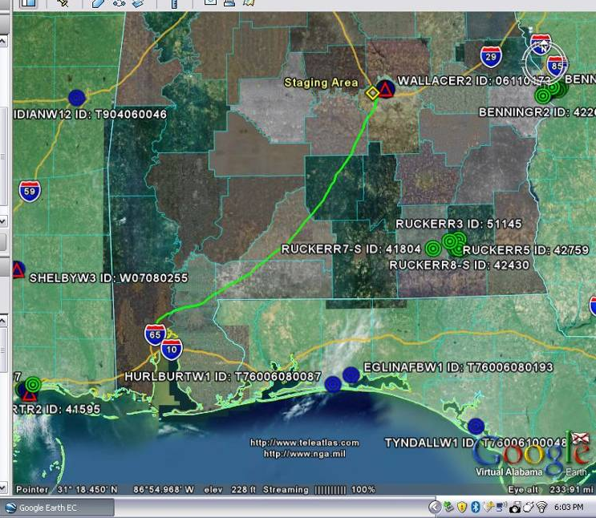
Virtual Alabama
Virtual Alabama has the ability to either pre-determine critical assets, staging areas, and routes, or determine rapidly based on mission requirements and situational awareness.
Alabama Critical Assets
Alabama Staging Areas

Slide 8
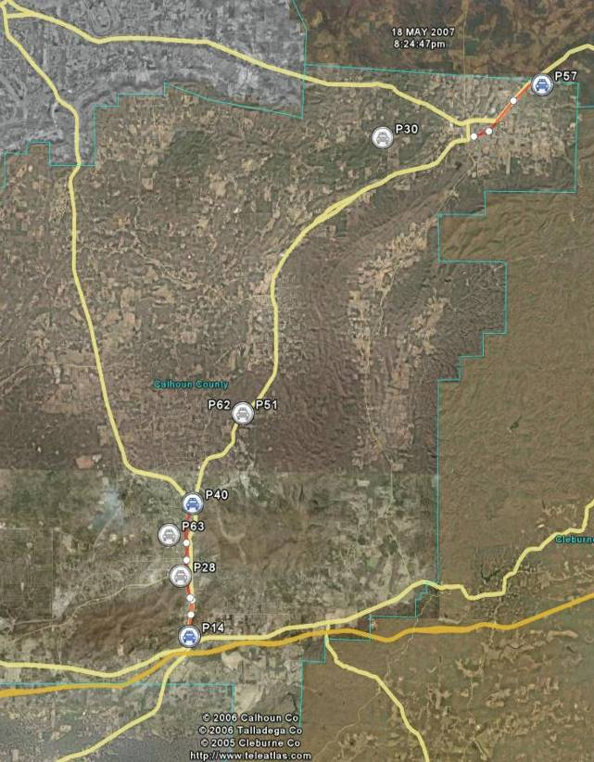
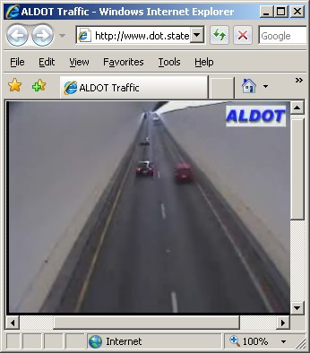
Real Time Information Feeds
Visibility of Multiple Disciplines
(Police and Fire)
Use of existing DoT WEB CAM

Slide 9
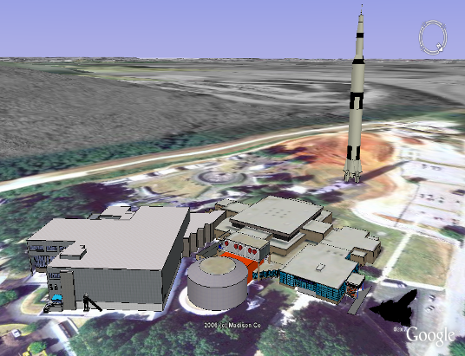
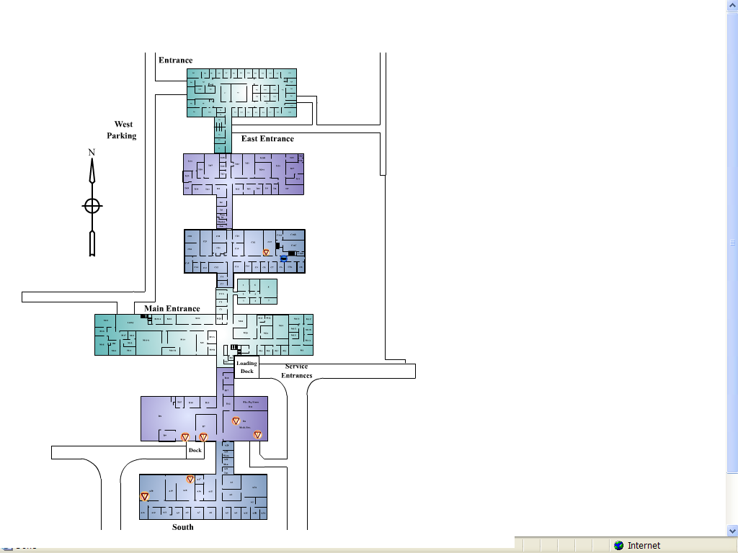
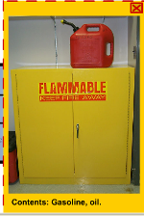
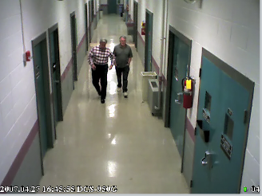
3D models can be enhanced with information about locations of hazardous materials as well as provide access to live video feed where available.

Slide 10
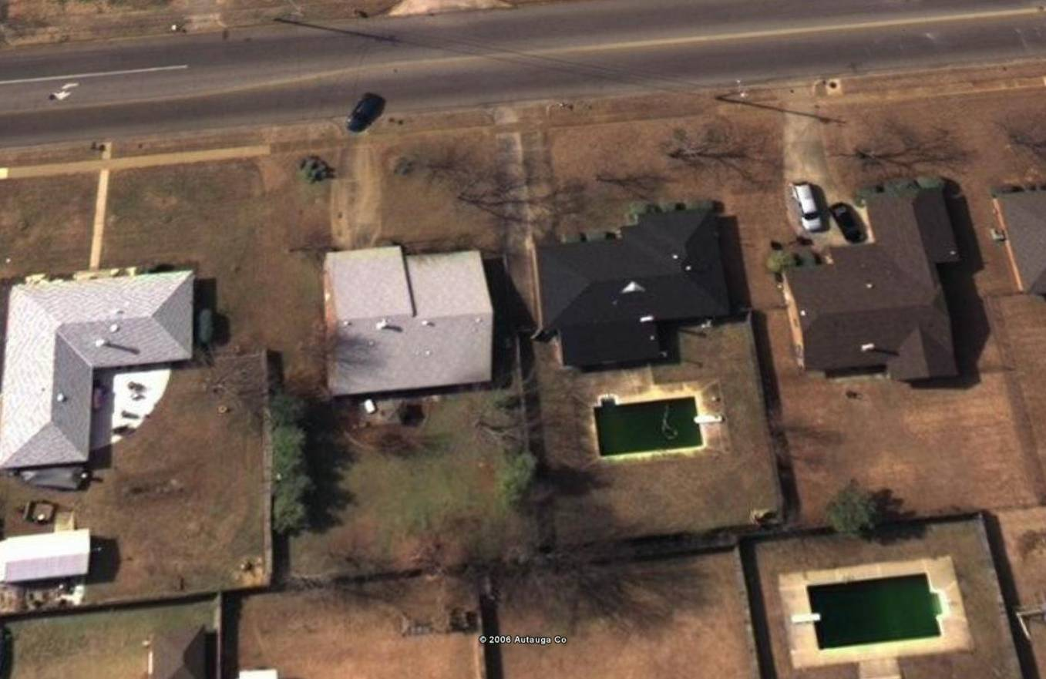
Virtual Alabama
And the ability to provide Before …
Used for Recovery Mission (determine $$ Value)

Slide 11
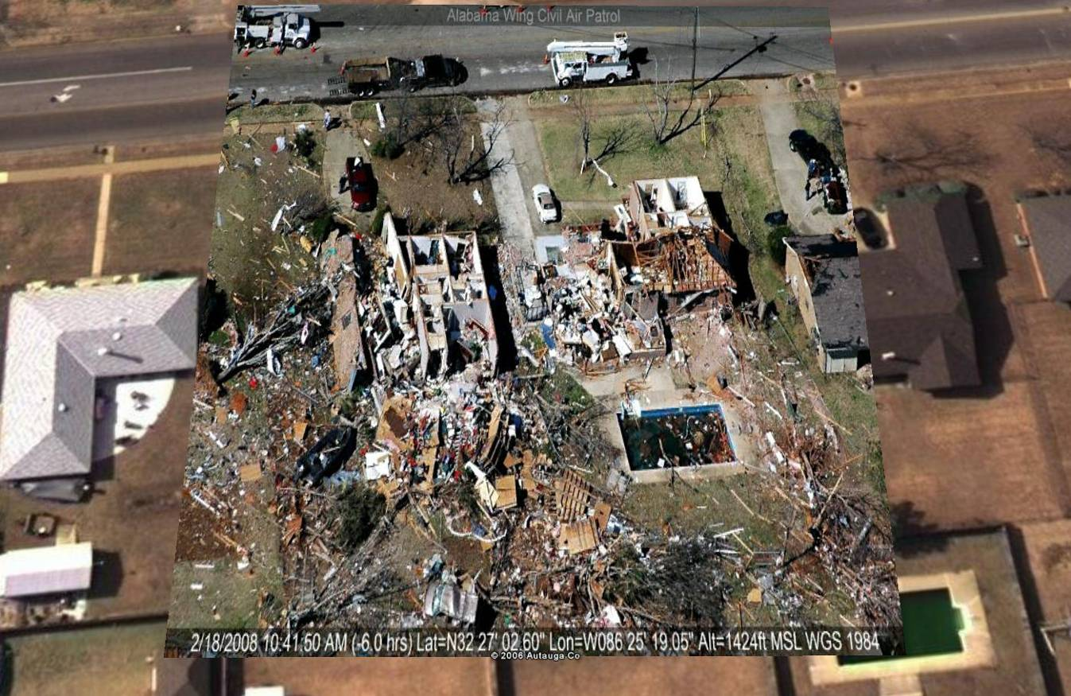
Virtual Alabama
… and After Situational Awareness of Area of Operation
Data provided within 4 hours of Incident, help with rescue mission

Slide 12
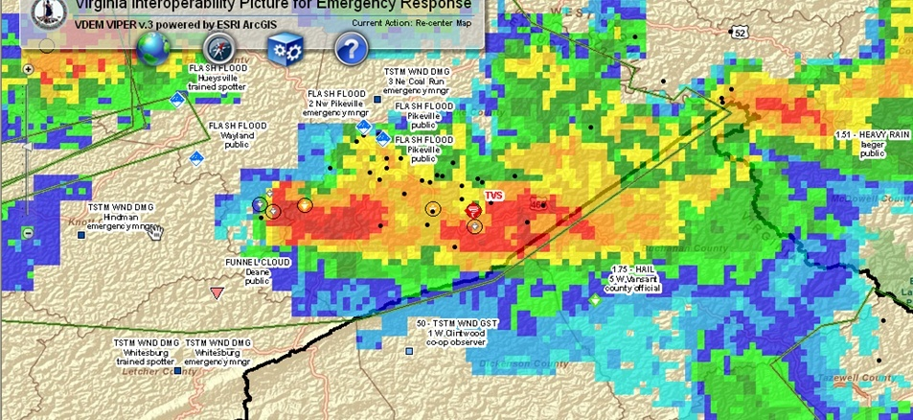
VIPER
Aids Decision Making (early warning notifications)
Notes:
This is a typical summer storm in Virginia, showing damage reports coming in via the National Weather Service’s SKYWARN network, as well as a Tornadic Vortex Signature (TVS) which is a RADAR indication of a forming tornado.

Slide 13
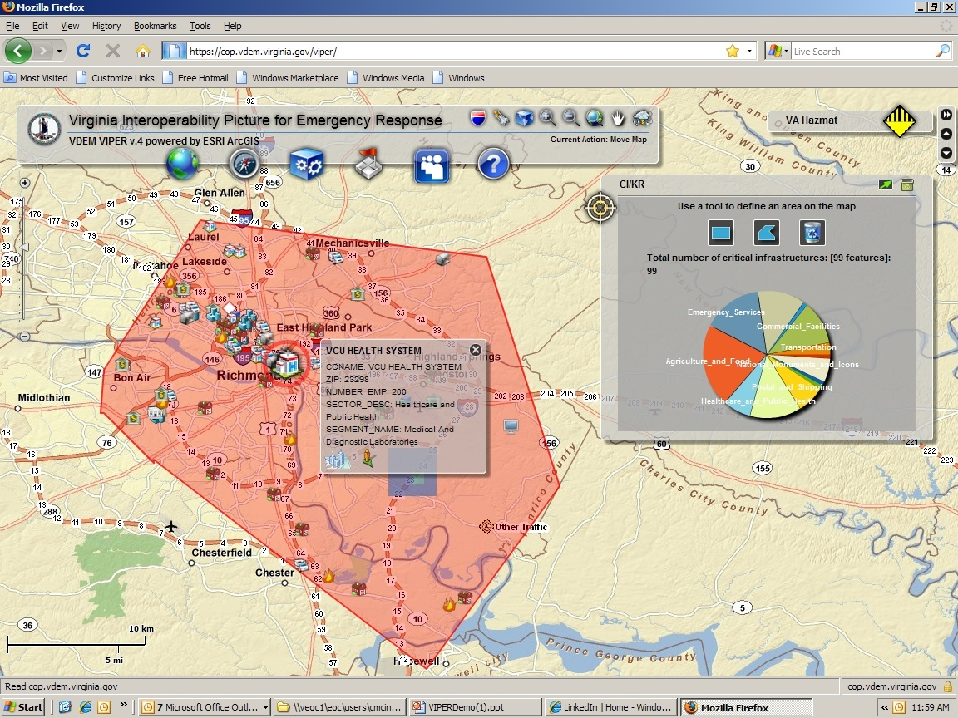
Critical Infrastructure Search
Notes:
Searching for critical infrastructure by drawing a polygon on the map.

Slide 14
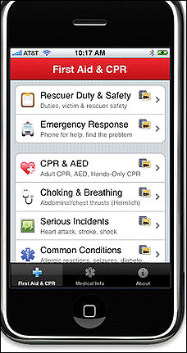
Making it Mobile

Slide 15
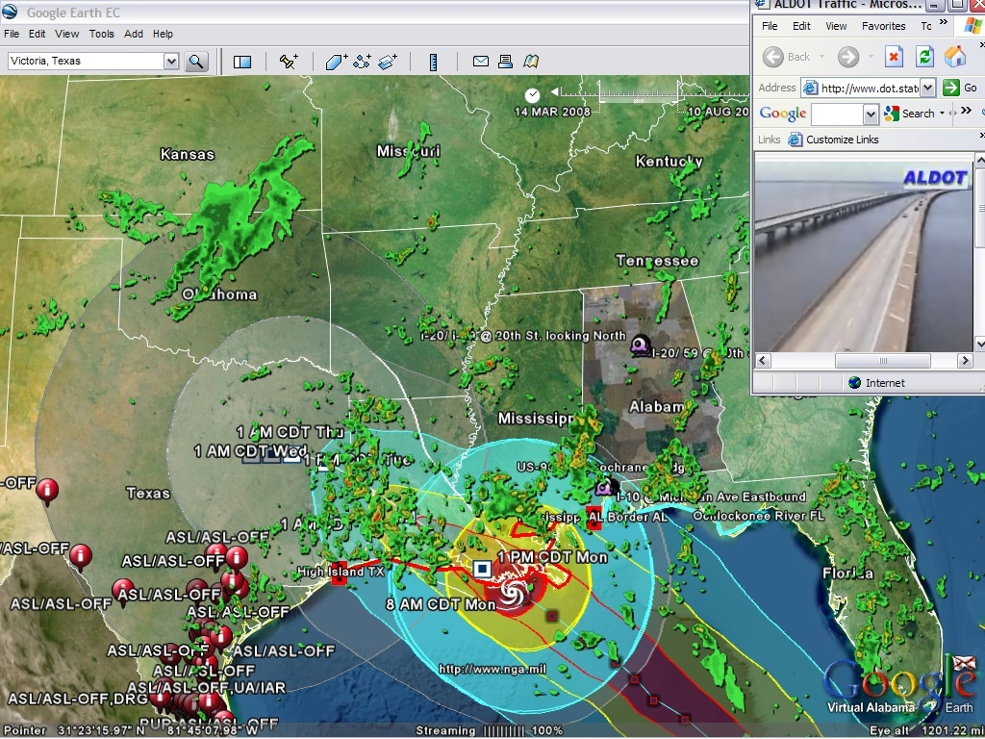

Slide 16
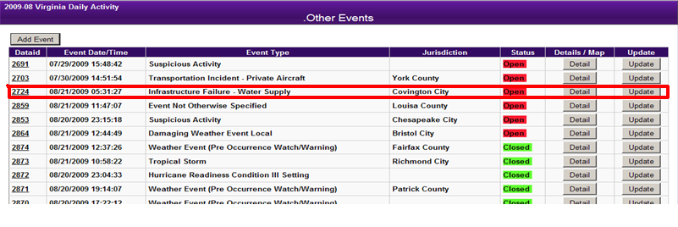
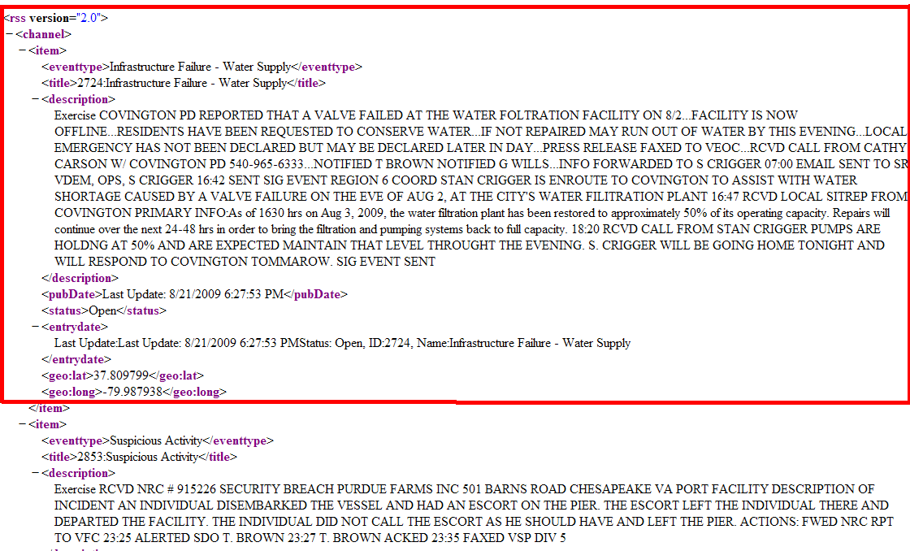
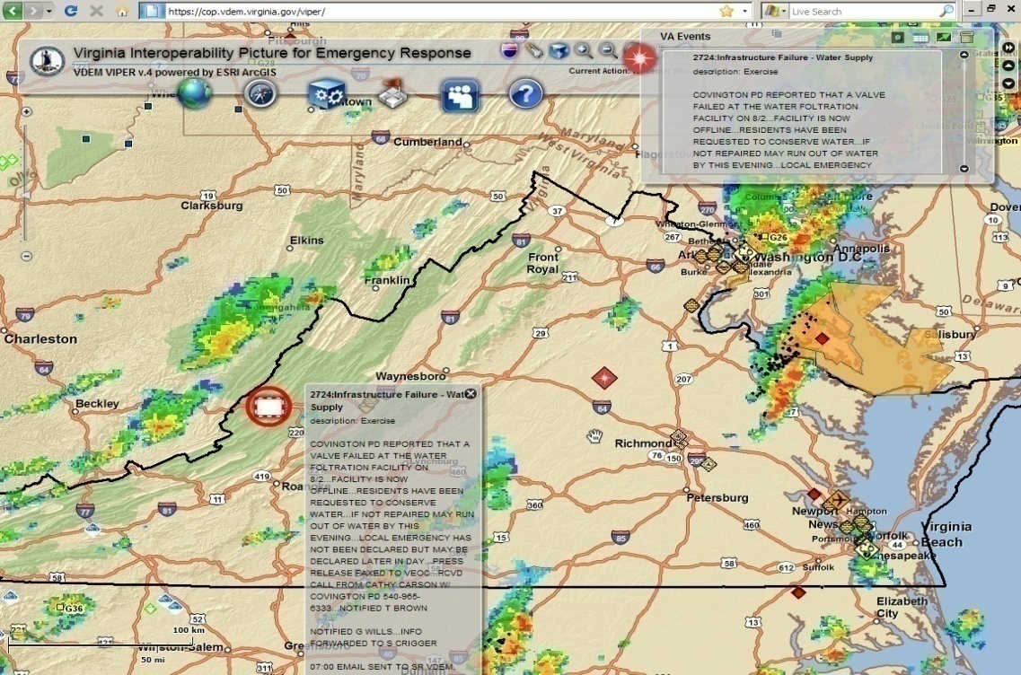
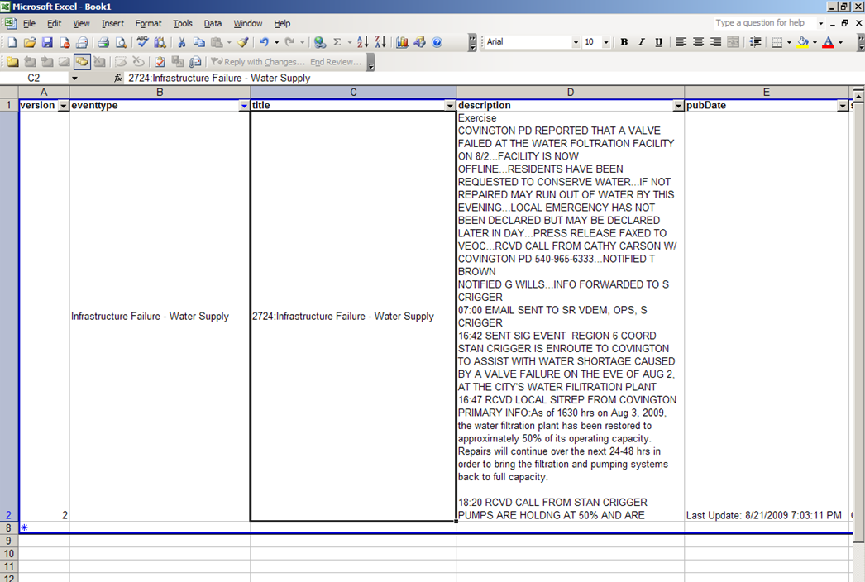
WebEOC
GeoRSS
VIPER
MS Excel

Slide 17
Virtual USA

Slide 18
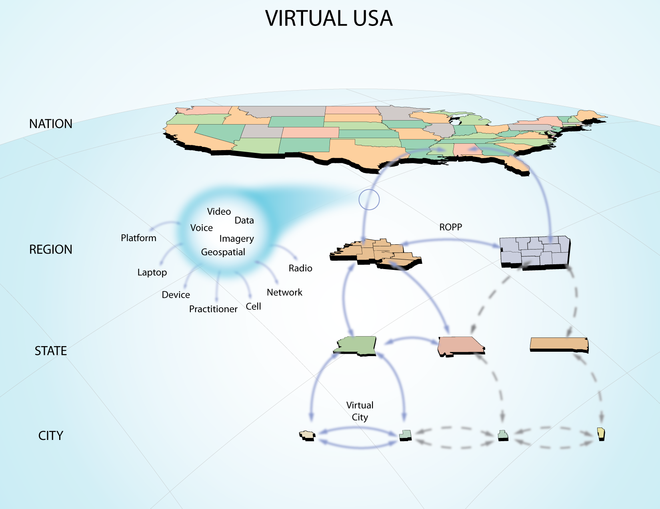

Slide 19
ONLY THE BEGINNING
rgreenberg@ghinternational.com
www.thehomelandsecurityblog.com

